Slide 1
Data-Driven College Decision
Gavin Hammersley, Matthew Spar, Anil Chandler

Slide 2
Bob wants to go to college
Bob is a senior in high school graduating in may and he is having troubles deciding where he wants to go. He came to us and asked if we were able to do an analysis and break it all down to help him decide where the best place for him to go to school would be.
Is he interested in a certain region? Type of school? Certain Major?

Slide 3
What did we work with?
College data frame
Unnamed: 0, Private, Apps, Accept, Enroll, Top10perc, Top25perc, F.Undergrad, P.Undergrad, Outstate, Room.Board, Books, Personal, PhD, Terminal, S.F.Ratio, Perc.alumni, Expend, Grad.Rate
Region data frame
School Name, Region, Starting Median Salary, Mid-Career Median Salary, Mid-Career 10th Percentile Salary, Mid-Career 25th Percentile Salary, Mid-Career 75th Percentile Salary, Mid-Career 90th Percentile Salary
Salary data frame
School Name, School Type, Starting Median Salary, Mid-Career Median Salary, Mid-Career 10th Percentile Salary, Mid-Career 25th Percentile Salary, Mid-Career 75th Percentile Salary, Mid-Career 90th Percentile Salary
Degree data frame
Undergraduate Major, Starting Median Salary, Mid-Career Median Salary, Percent change from Starting to Mid-Career Salary, Mid-Career 10th Percentile Salary, Mid-Career 25th Percentile Salary, Mid-Career 75th Percentile Salary, Mid-Career 90th Percentile Salary

Slide 4
What is our plan?
We will be exploring four different college datasets using different techniques. Each dataset contains various features that will be used to explore different techniques. These techniques are PCA, TSNE, and K-means clustering, we aim to uncover patterns and insights within the data that could be useful for prospective students and educators.
Simple EDA on our original data
Different types of clustering
DIfferent types of visuals to explain our data
Create a story in order to explain what a possible college decision could come from our findings

Slide 5
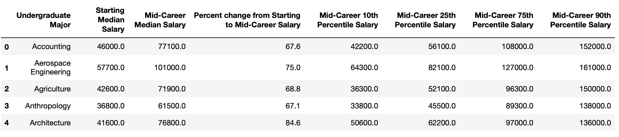
Simple EDA/cleaning
Non-numerical values
Filling NaN slots
Renaming columns
Sorting Data

Slide 6
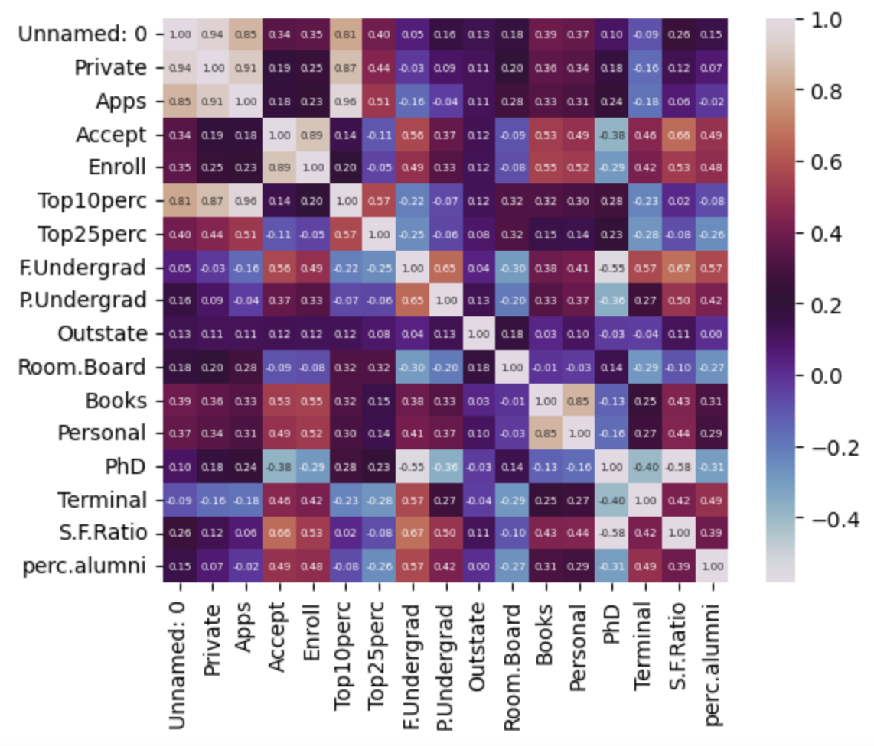
Relations
A heat map represents data in a way that shows the relationships of two variable plotted on the x axis and y axis.
In a heat map, each cell in the matrix or table is colored based on the value of relations.
We used the college data set to show this heat map, but each data set was relatively the same.

Slide 7
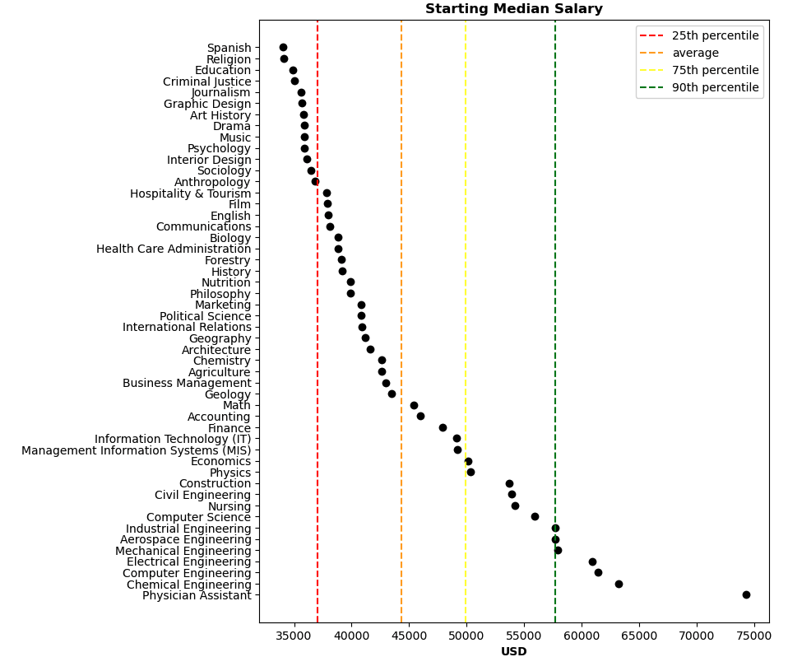
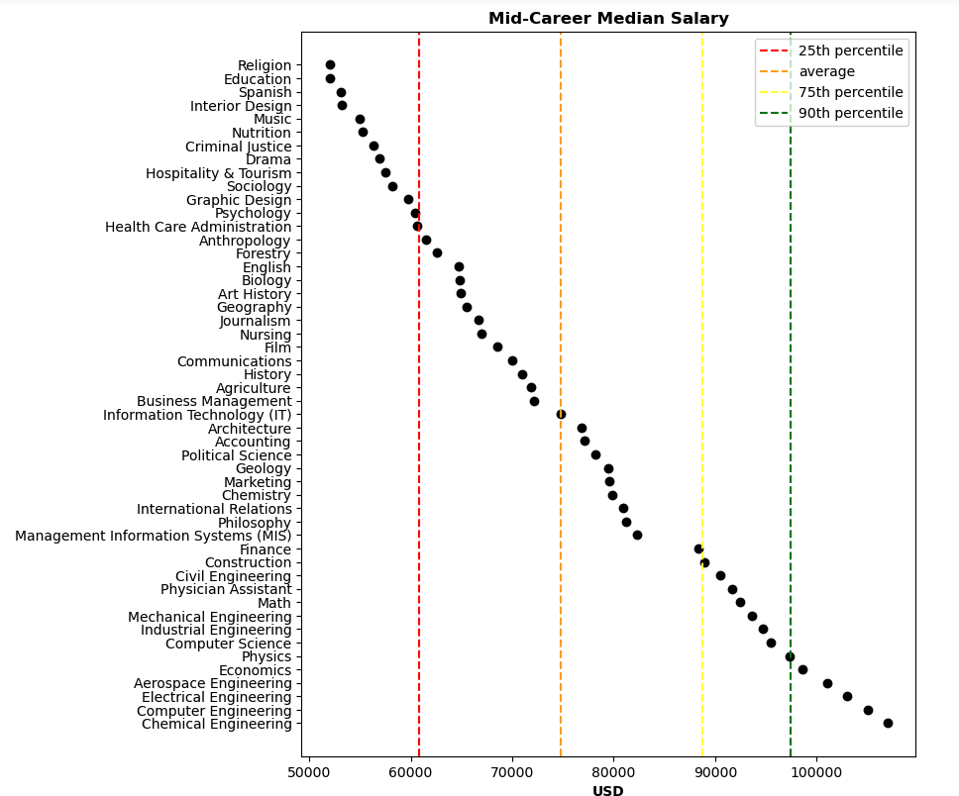
Percentile Visuals

Slide 8
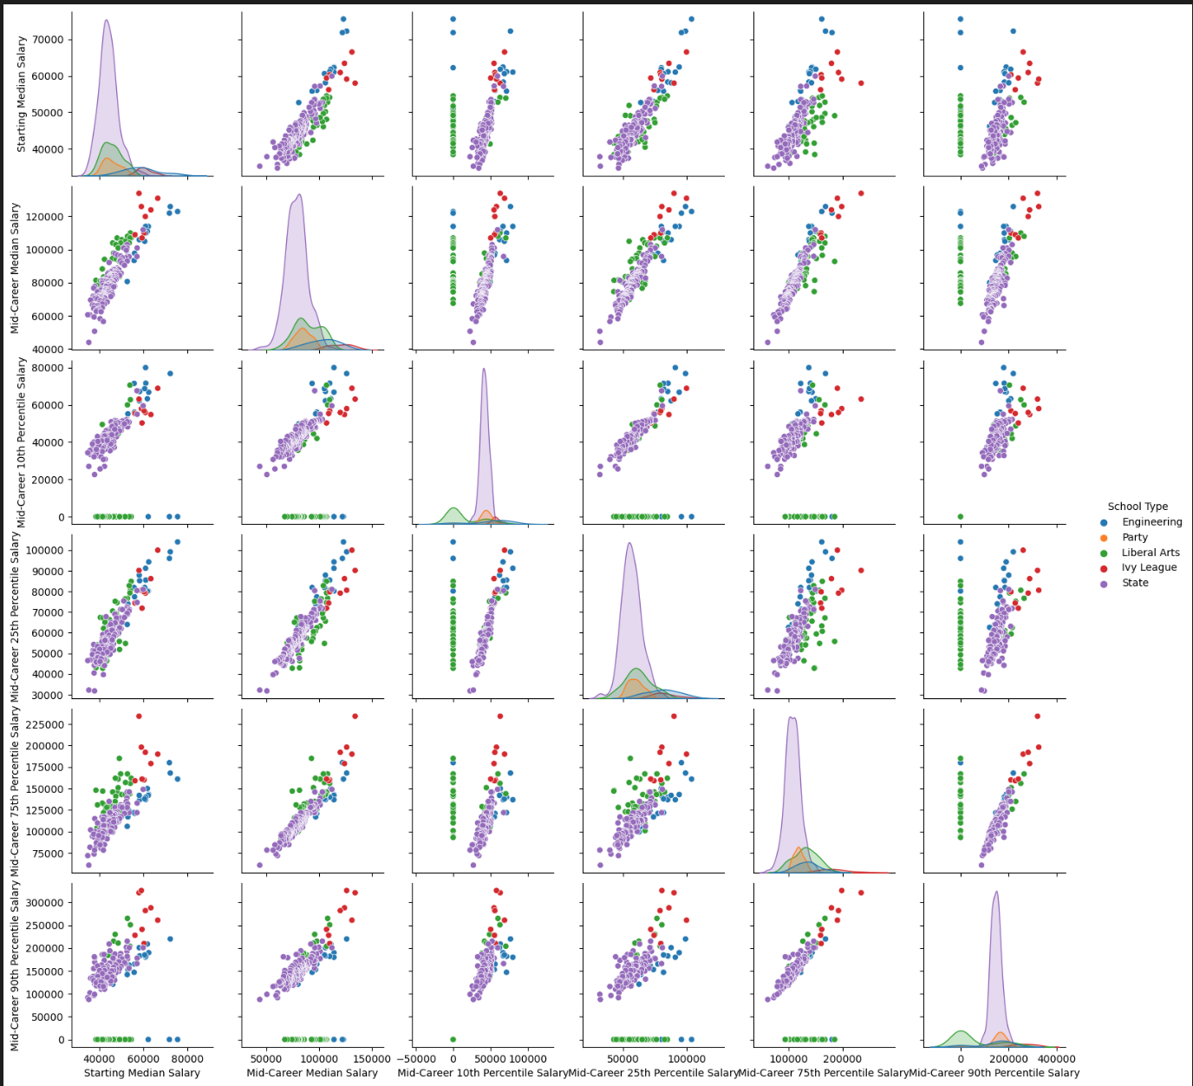
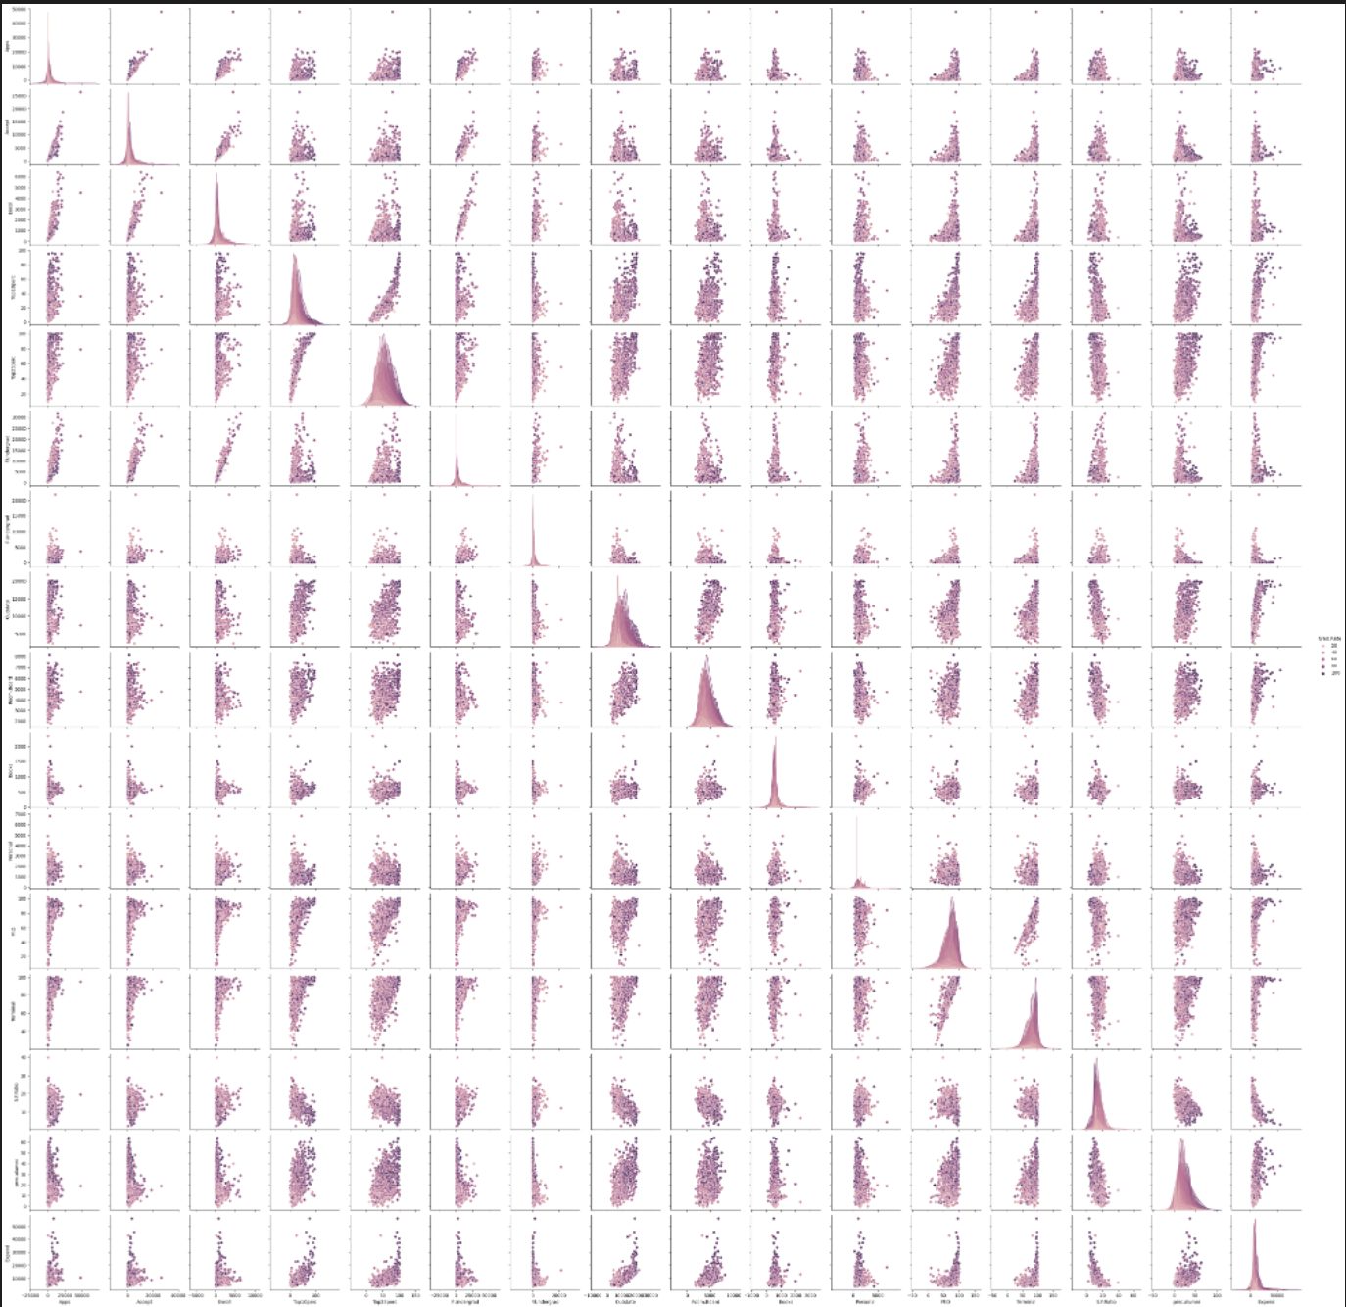
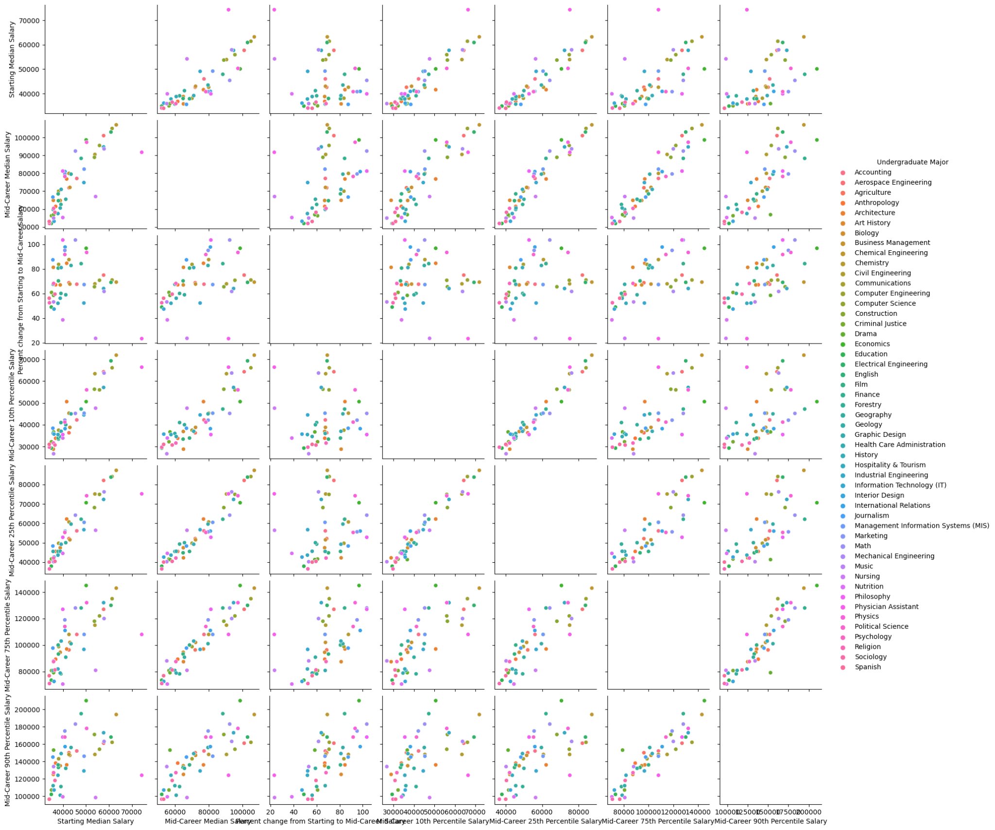
Graduation Rate
School Type
Majors

Slide 9
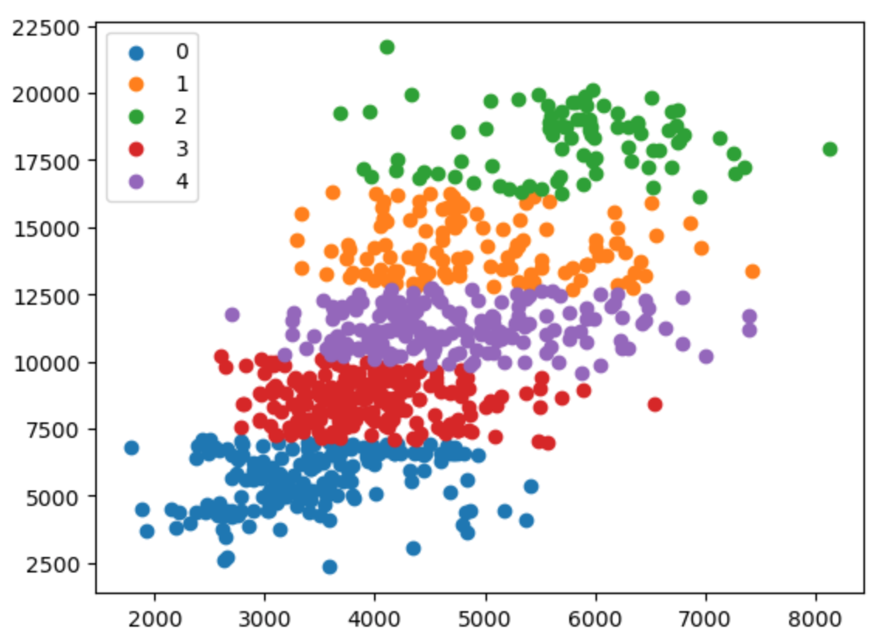
Clustering
K-Means: showing common relations in the data that aren't otherwise grouped.
Used College DataFrame

Slide 10
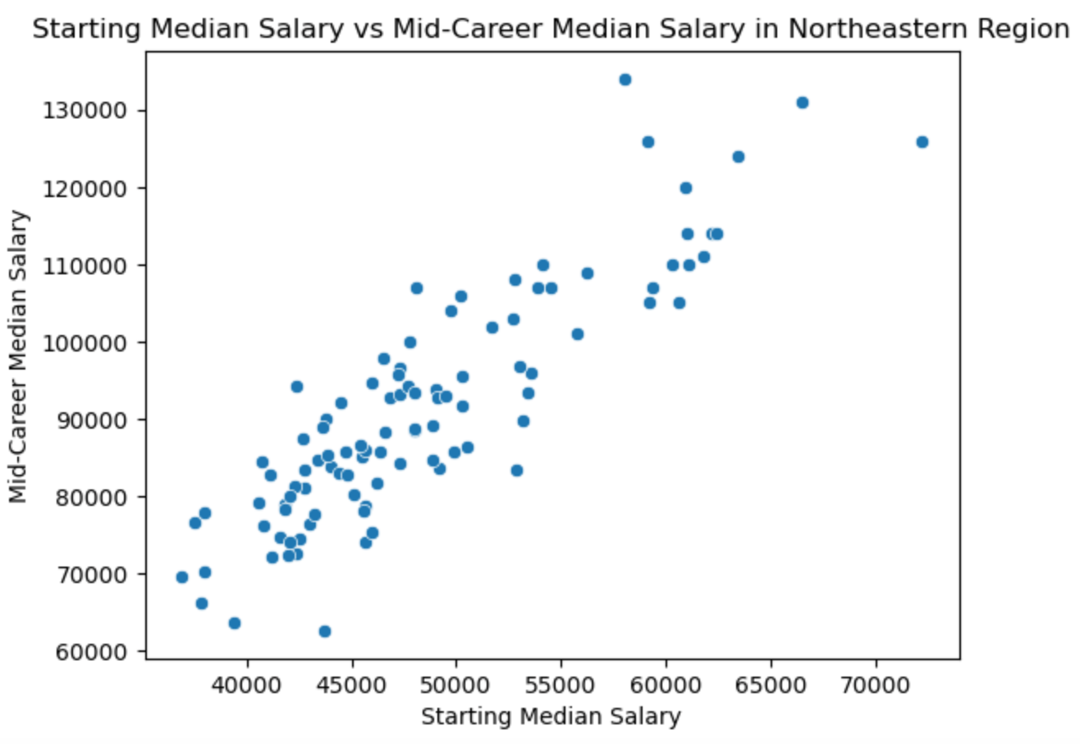
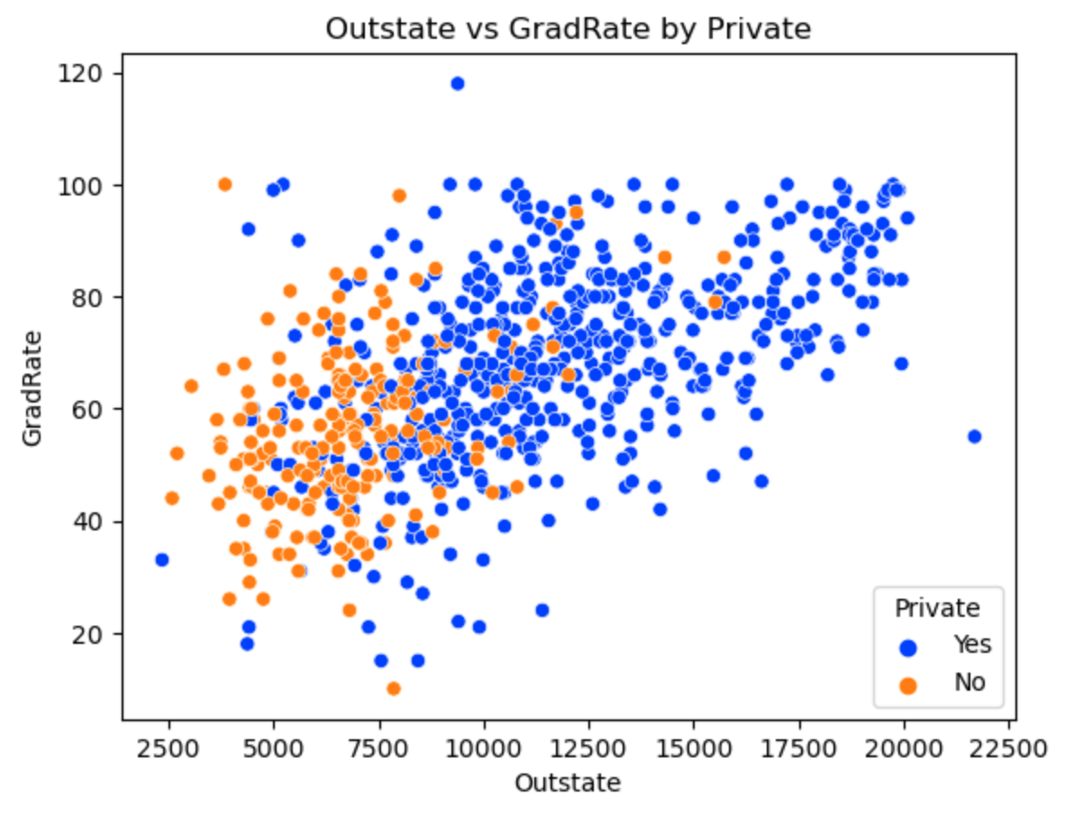
Clustering
There is a clear difference in the scatter plot in the Northeastern Regions.
Outliers are going to be in the data no matter where you look.
Clear indication that the graduation rate on a private school vs public schools is higher.

Slide 11
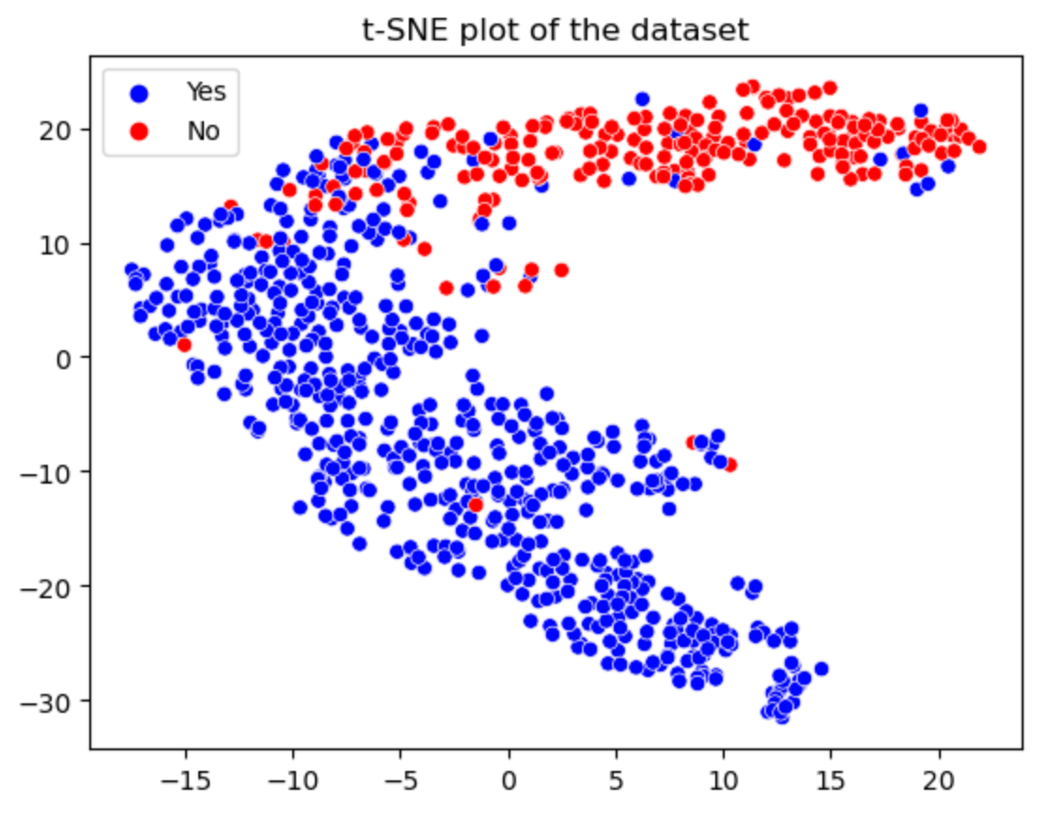
Clustering
3. T-SNE: show us the probability distribution of neighbors around each other in a high-dimensional perspective
We did this on the college df and used the column ‘Private’ to be our key.
How closely related the private and non-private schools are.

Slide 12
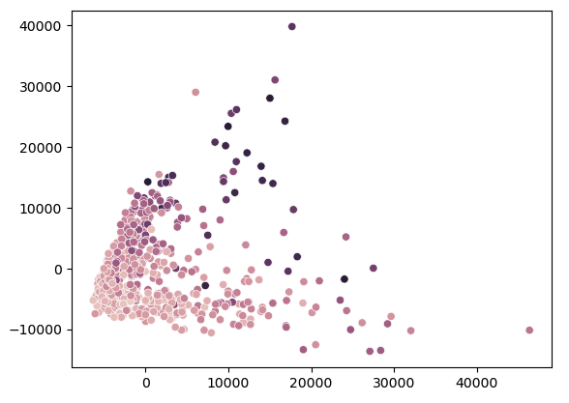
Clustering
4. PCA
Top 10% of schools
Negative related
Outliers (40k+ region)
Date unknown could mean that something in the region is affecting the data.

Slide 13
What did this show us?
Data Points
Relationship between different colleges, pay-rates, and regions
Allowed understanding of matrix relations (heat map)
Out of state vs In-state graduation rates
Data Interpretation
Starting and Median pay rates growing
Some schools that have negative relation as well as some with positive.
Great difference with private and public schools.

Slide 14
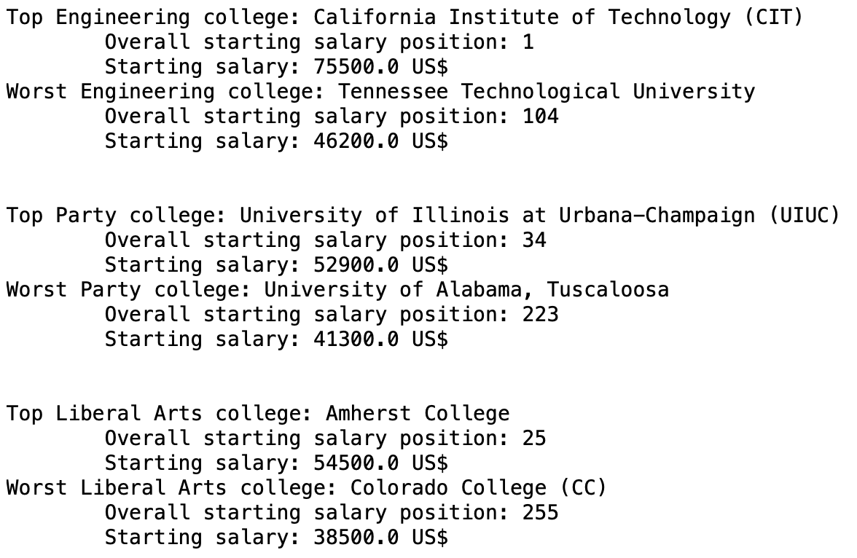
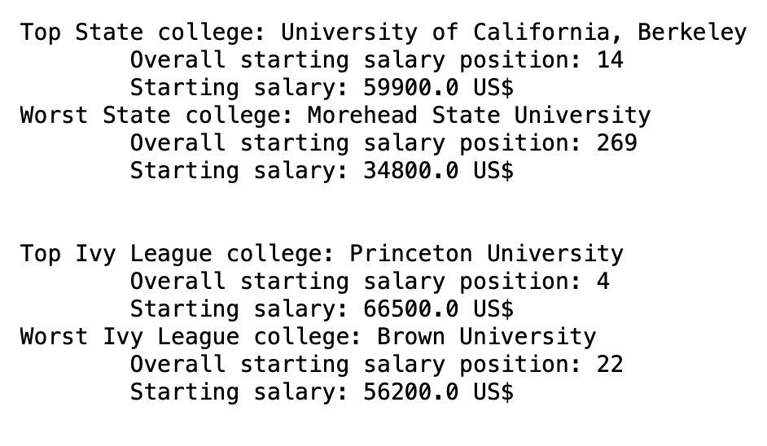
Bob’s decision
Based of our 5 different types of schools we were able to come up with this to help bob

Slide 15
Summary
Business Advantages Behind Our Data
Recruitment
Determent
Efficient / Easy to Understand
Other Possible Uses for these Algorithms
Cars (Performance vs Costs)
Food Sales (Regional)

